Slide 1

Nerd Trivia
Challenge yourself and learn!

Slide 2
Are you a nerd? Like… full sweat? Are you sure? Well then, brave adventurer, do we have a trivia game for you! This game is FULL of epix and lore. From video games to movie trivia, it’s got it all. Do you have what it takes to claim the high-score? Are you the king of the hill?
Then Test Your Nerd Knowledge Now!!!
Elevator Pitch!!

Slide 3
Concept
The Nerd Trivia game is a web application that presents the user with 10 randomized multiple-choice questions on the subject of general video games. The user must enter their username in order to play the game. After completing the quiz, the final score will be displayed. The highest score will then display on the homepage.
Trivia games like this are a great way to compare your knowledge against others, and a way to know more than when you started.
User story:
AS A user
I WANT to play a trivia game
SO THAT I can test my knowledge of video games

Slide 4
Process
Technologies used include:
HTML
The Bootstrap CSS Framework, implementing a non-native modal dialog
JavaScript, used to store and retrieve the data in client-side persistent storage
GitHub Pages to host the site
Breakdown of tasks and roles:
Html: Elhadj Bah: trivia question content, html layout and River Hagen: html layout, slide deck
CSS Framework: Dillon Duran: frontend Bootstrap and custom styling
JavaScript: Clint Jones: quiz logic (with help from Geronimo Perez, gperez@instructors.2u.com), css modals. Robert Grabowski: localStorage, page redirects

Slide 5
Challenges and Successes
Challenges: Trouble breaking into smaller tasks, Difficulty planning the UI flow.
Successes: Adapted to updates using a testbed temporary page. Broke out major features into individual css and js files to avoid work conflicts, redirecting to certain pages using buttons and clickable images!

Slide 6
Demo

Slide 7
Directions for Future Development
Support additional subjects, expand the number of questions, bonus round, track score ranking for multiple players for a top score
Store questions, answers, username and their highest score ranking in a database
Add game modes like “Speedrun” in which the user has a given amount of time to complete the quiz
Randomize different questions, so that the quiz won’t be the same
Add an actual create/login screen for customizable profiles. This include badges and achievements.

Slide 8
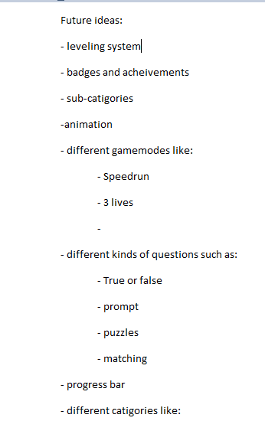

Slide 9
Links
Deployed: https://clintsrc.github.io/nerd-trivia/
GitHub repo:
Home page: https://github.com/clintsrc/nerd-trivia
Repository: git@github.com:clintsrc/nerd-trivia.git

